Slide 1
PROJECT REPORT Loan Default Prediction using Machine Learning Techniques Submitted towards the partial fulfillment of the criteria for award of PGA by Imarticus Course and Batch: DSP-36 July-2019
Submitted By: Amit Singh
Aryan Pandey
Vivek Kumar Patel

Slide 2
INTRODUCTION The objective of our project is to predict whether a loan will default or not based on objective financial data only and whether investors should lend to a customer or not. Data from 2007-2015 will be used because most of the loans from that period have already been repaid or defaulted on.
Data sources
The provided dataset corresponds to all loans issued to individuals in the past from 2007-2015. The dataset has 855969 observations and 73 features.

Slide 3
Exploratory Data Analysis Missing value analysis and Another treatment
In our dataset our target shows that 94% have not defaulted and 6% are defaulters or charged off. So this is clearly an unbalanced dataset.
Our dataset has 855969 rows × 73 features including the target out of which 32 have missing values or NAN.
policy_code is always == 1
payment_plan has only 10 'y' values and 887372 'n' values
id and member_id are all unique, which is a bit misleading. So every record is a unique customer
application_type is 'INDIVIDUAL' for 99.94% of the records
acc_now_delinq is 0 for 99.5% of the records
emp_title not needed here, but it might be useful for the modelling (see below)
zip_code not needed for this level of analysis
title can be removed as well.

Slide 4
Purpose of loan
Drop records where values are less than 0.75%.
We will analyze only those categories which contain more than 0.75% of records. Also, we are not aware what comes under 'other' we will remove this category as well.
We are dropping columns that has more than 7 levels (categories) since it is not feasible to one hot encode them. The variable we removed are 'earliest_cr_line’ ,'addr_state'. We're not removing issue_d because the variable need to be used for splitting.

Slide 5
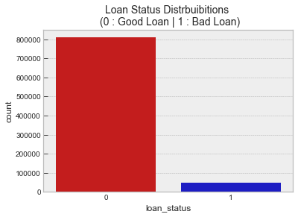
Target Variable
The Graph Shows that the target class is highly imbalanced which we will deal with before doing modeling on data.
Good Loan 94.57% of the Data Set.
Bad Loan 5.43% of the Data Set.
94% have not defaulted(fully paid) and 6% are defaulters or charged off.

Slide 6
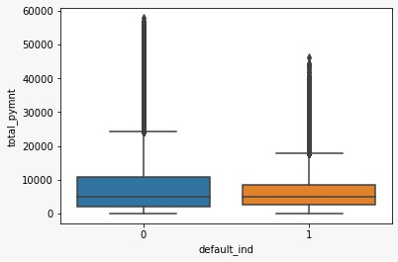
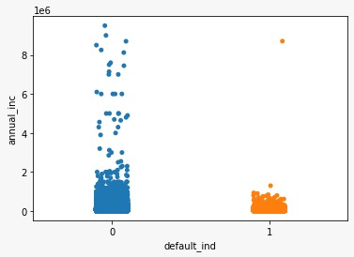
outliers
There are no outliers in the 'int_rate' Column.
Shows some outliers in 'annual_inc' but due to the importance of this feature we decided not remove these .

Slide 7

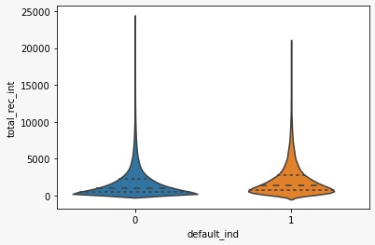
show that 'total_pymnt' & 'total_rec_int' also dont have outliers that need to be removed
By doing similar plots for inq_last_6mths, out_prncp, total_rec_prncp, recoveries, collection_recovery_fee, last_pymnt_amnt we found that either the outliers were not present or due to fature importance could not be removed.

Slide 8
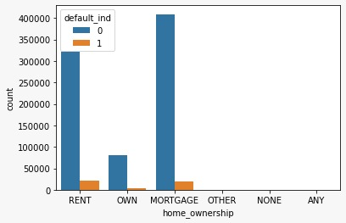
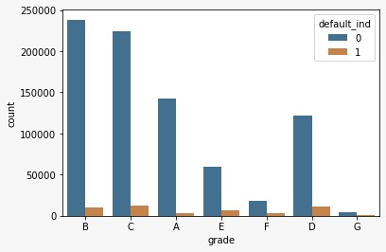
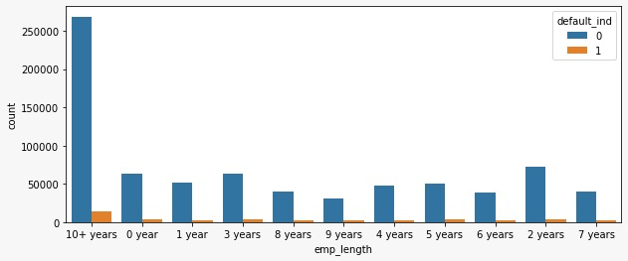
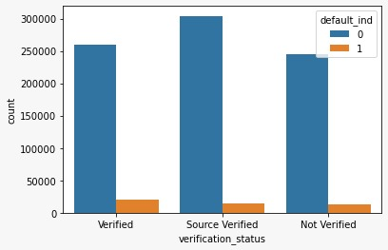
Categorical variables
Categorical variables like Verification Status, initial_list_status, Term, Grade, Home_Ownership, emp_length were converted to integers for better understanding in th model.

Slide 9
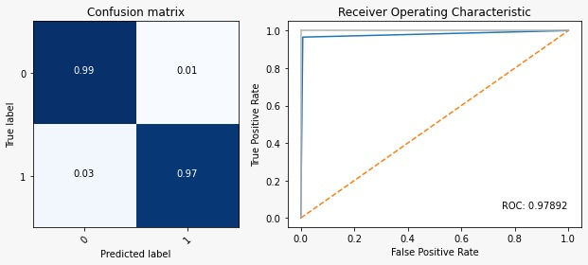
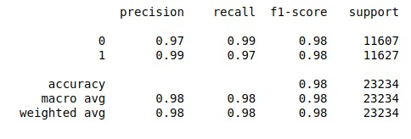
Confusion matrix,ROC Curve and classification_report
The confusion matrix and roc curve graph shows that the model was able to correctly classify the labels with little error.
In our case of predicting if a loan would default — it would be better to have a high recall as the bank don’t want to lose money and would be a good idea to alarm the bank even if there is a slight doubt about defaulter. Low precision, in this case, might be okay. The classification report give us exactly that ensuring that the model performance is good.

Slide 10
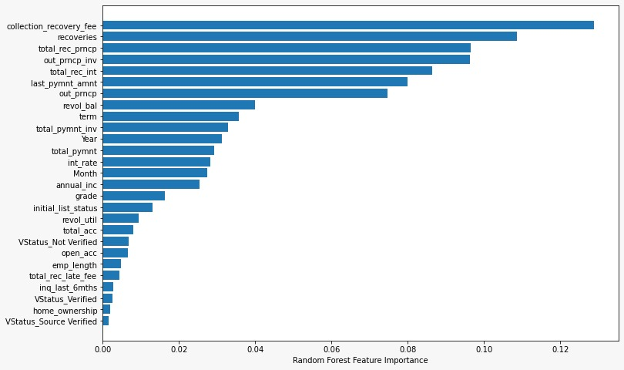
importance of various features
Random Forest model gave a list of important features for this entire process that can be considered by bank while issuing loan.

Slide 11
Conclusions
Fields like zip code & policy code barely are of any significance so such fields can be ignored from our study.
Based on annual income & purpose, lending organization can decide how much loan to finance. For e.g.- If a customer has a higher salary or source of income is fixed, he can be financed loan.
Columns depicting delinquency can be kept in binarized format by bank. So if someone has no default history it can be taken as zero and if someone has defaulted in 1 or more than 1 month can be simply labelled as 1 i.e. Delinquency.
Columns depicting delinquency can be kept in binarized format by bank. So if someone has no default history it can be taken as zero and if someone has defaulted in 1 or more than 1 month
can be simply labelled as 1 i.e. Delinquency.
A higher interest rate can be charged from those who have defaulted as a form of penalty, so they don’t default from next time.
Finally, random forest model gave a list of important features for this entire process that can be considered by bank while issuing loan.

Slide 12

Thank You

